Slide 1
Minimalism
part 2

Slide 2
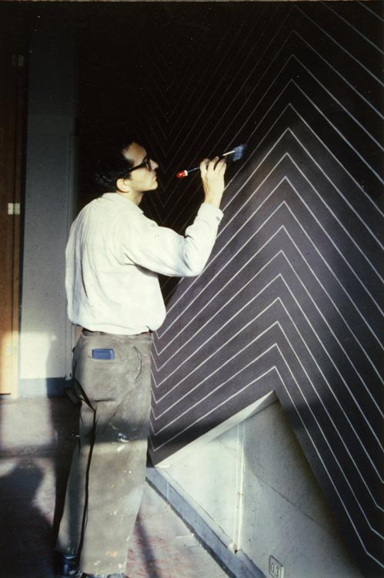

Frank Stella
Notes:
Frank Stella was also grouped with the Minimalists, but the longer they knew each other, the more Stella and Judd disagreed about what made good minimalist artwork.

Slide 3
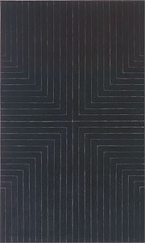
Notes:
Stella worked with ordinary house painting brushes and paint, but he was still working by hand along with all the blurry edges and brush strokes that that comes with. Notice through repetition how he has created a sense of depth in this piece. All the lines in this piece are either horizontal or vertical, but our eyes fill in four diagonal lines which seem to recede in space from the center towards the corners.

Slide 4
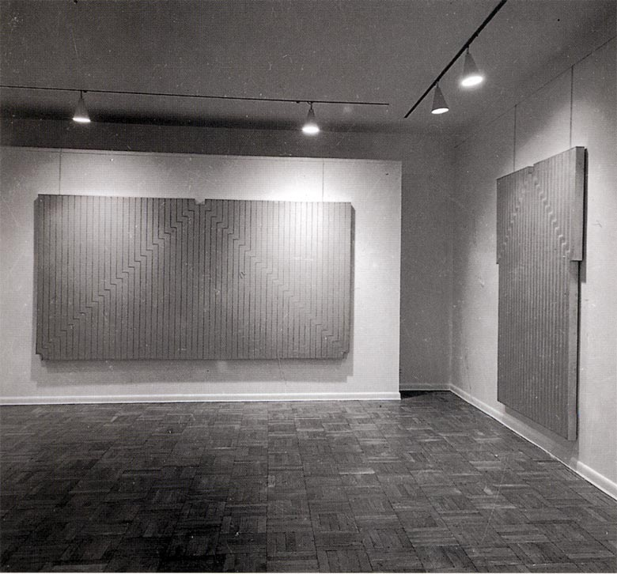
Notes:
Stella's paintings were stretched on thick 3" stretchers, and Donald Judd wanted to think of them as slabs hanging on the wall. Again his idea of new works that were neither painting or sculpture. But Stella saw his works strictly as paintings, and believed he was very much continuing the history of painting rather than breaking with it.

Slide 5
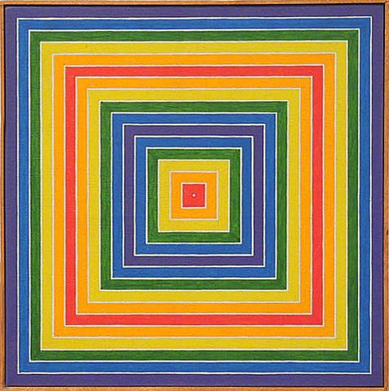
Notes:
When he adds color into his compositions, a new level of reading is introduced. Just like with Hofmann we have the competing readings based on form, which tells us we are looking down into a tunnel, and color, which bounces around based on warms and cools.

Slide 6
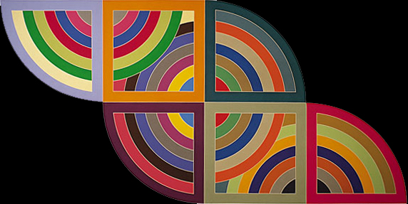
Notes:
The later work of Stella becomes more and more complex, until it can hardly be called minimal at all. The organization of color and form tells our minds many conflicting stories here, which take careful observation in order to work out.

Slide 7
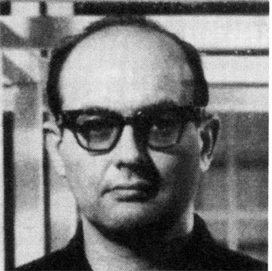
Sol LeWitt
Notes:
Besides Minimalism, Sol leWitt is also seen as part of the Conceptual Art movement.

Slide 8
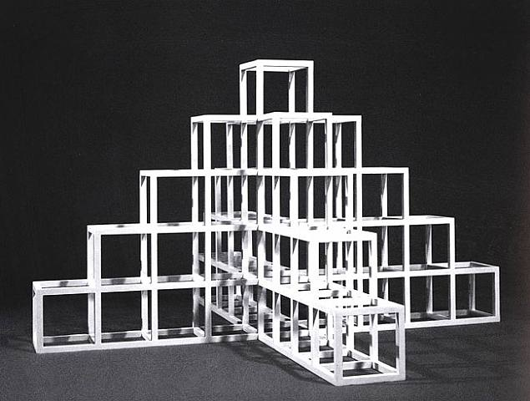
Notes:
He believed the most important part of an artwork was the idea itself, and tried to create artworks that emphasized thought over material.

Slide 9
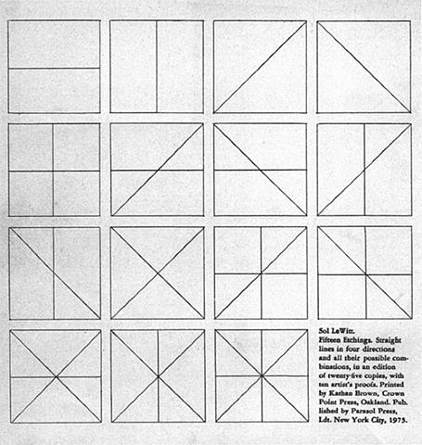
Notes:
Many of his works involved the idea of permutations, that is, different combinations of a set of conditions. For instance, here is the frontispiece for a set of etchings. Each one represents one combination of a horizontal, vertical or left or right diagonal line. Between the fifteen pieces all possible combinations are represented.

Slide 10
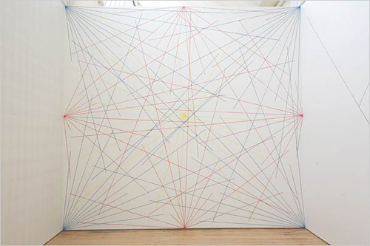
Notes:
The pieces he is most well know for might be his wall drawings. In these pieces a set of instructions are given to the production team, who interpret the instructions and create the pieces on the wall without the artist present.

Slide 11
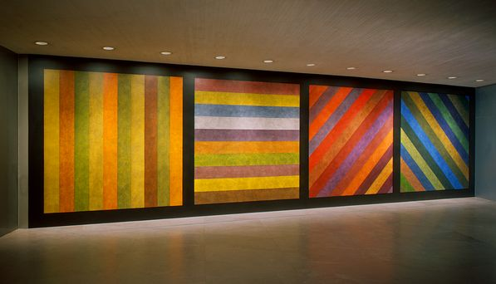
Notes:
Some of the later work includes rich colors as well, instructing the installation crew to use colored ink washes applied directly to the wall. Notice how the directions in this piece are based on the same line directions he use in the set of etchings we just saw.

Slide 12
Images:
Frank Stella (b. 1936)
Die Fahne Hoch, 1959
Installation shot, 1960
Grand Cairo, 1962
Harran II, 1967
Sol Lewitt (1928 – 2007)
123454321+, 1960s
Straight Lines in 4 Directions and All Their Possible Combinations, 1975
Sol Lewitt, Wall Drawing #273: Lines to points on a grid, 1975
Wall Drawing, 1993
Notes:
Frank Stella (b. 1936)
Die Fahne Hoch, 1959
Installation shot, 1960
Grand Cairo, 1962
Harran II, 1967
Sol Lewitt (1928 – 2007)
123454321+, 1960s
Straight Lines in 4 Directions and All Their Possible Combinations, 1975
Sol Lewitt, Wall Drawing #273: Lines to points on a grid, 1975
Wall Drawing, 1993

